Slide 1

Three-Class Diabetes Status Prediction with Failure-Aware Ensemble Learning and Explainable AI

Slide 2
PROBLEM STATEMENT
Diabetes is a major public-health challenge influenced by multiple demographic, behavioral, and health-related factors.
Predicting No Diabetes, Prediabetes, and Diabetes is challenging because the three classes are highly imbalanced, with Prediabetes being severely underrepresented.
Conventional machine learning models can achieve reasonable overall accuracy while performing poorly on minority classes.
Existing approaches often focus mainly on model performance without sufficiently analyzing model failures, confidence, disagreement, and complementary behavior.
There is a need for an integrated framework combining multi-model prediction, failure-aware ensemble learning, explainable AI, and population-level diabetes surveillance.

Slide 3
METHODOLOGY
Performed data preprocessing, exploratory data analysis, statistical analysis, and feature engineering on BRFSS health-indicator data.
Developed and compared multiple machine learning models for three-class diabetes status prediction using comprehensive performance metrics.
Analyzed model failures, confidence, disagreement, and error overlap using out-of-fold predictions to identify complementary model behavior.
Developed a Failure-Aware Hybrid model using model predictions and behavior-based meta-features for final three-class classification.
Evaluated the proposed hybrid against individual models, Soft Voting, and Standard Stacking using a locked test set.
Integrated SHAP and LIME for interpretable predictions and analyzed model calibration and subgroup performance.
Integrated CDC diabetes surveillance analytics with the predictive framework into an interactive dashboard for population-level insights and decision support.

Slide 4
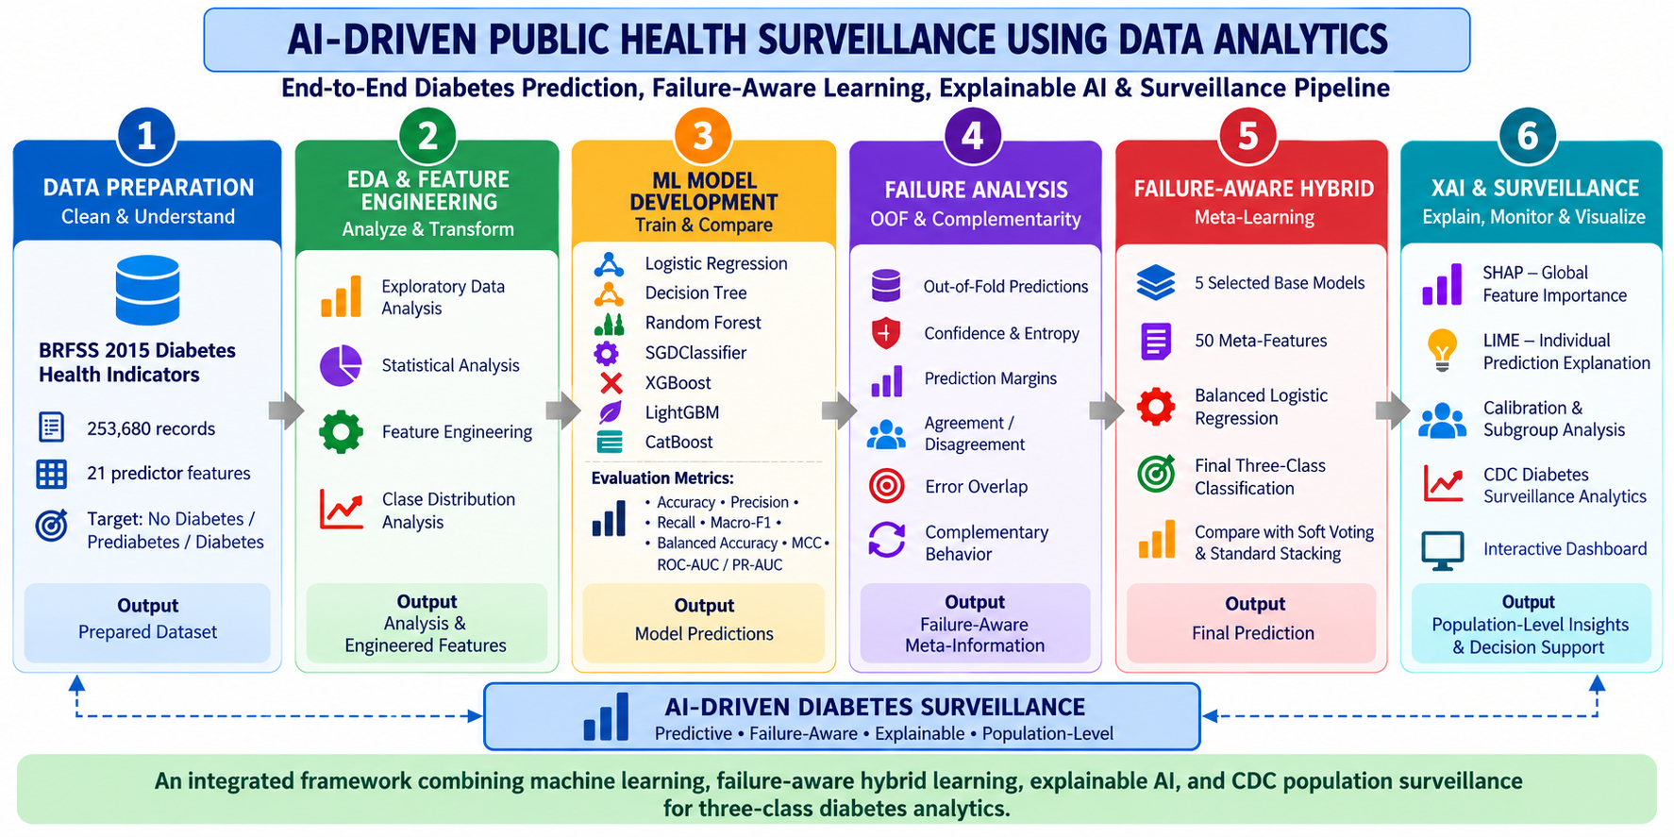
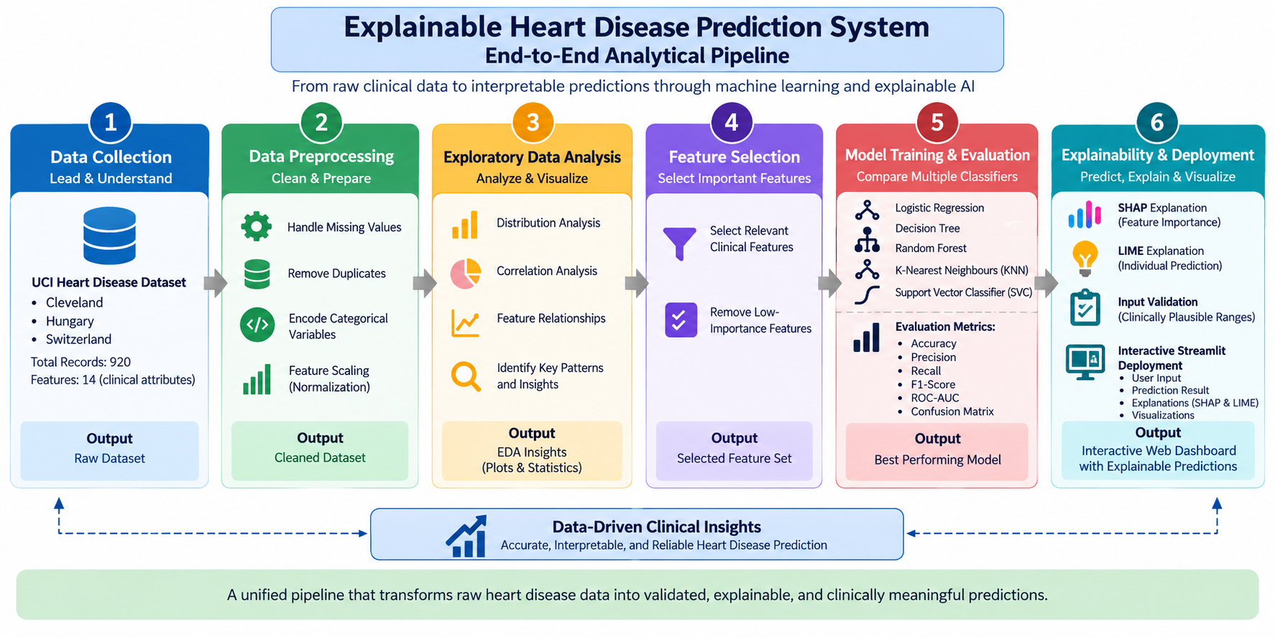
SYSTEM ARCHITECTURE
Resarch Paper | Publication | Key Contribution | Limitations
Feature-Limited Prediction on the UCI Heart Disease Dataset (2023) | Computers, Materials & Continua | Performs EDA on the UCI dataset, examines feature distributions and missing values, applies feature selection, and compares multiple ML models. | Limited to EDA and feature selection; does not incorporate explainability or a deployment interface.
An Active Learning Machine Technique Based Prediction of Cardiovascular Heart Disease from UCI-Repository Database (2023) | Scientific Reports | Performs preprocessing, EDA, and visualizatio to examine attribute relationships before applying multiple ML classifiers. | Focuses on classification performance only; lacks explainability (SHAP/LIME) and input validation.
Mixed Machine Learning Approach for Efficient Prediction of Human Heart Disease by Identifying Numerical and Categorical Features (2022) | Applied Sciences – MDPI | Uses combined UCI data (Cleveland, Hungary, Switzerland, VA Long Beach); analyzes numerical/categorical features and compares ML approaches. | Does not include model interpretability or an interactive deployment component for practical use.
Finding the Influential Clinical Traits that Impact on the Diagnosis of Heart Disease Using Statistical and Machine-Learning Techniques (2022) | Scientific Reports | Investigates feature importance using statistical and ML techniques before applying tree-based classifiers on the combined UCI dataset. | Limited to feature-importance analysis; lacks broader model comparison and explainability integration.
The Efficacy of Machine-Learning-Supported Smart System for Heart Disease Prediction (2022) | Healthcare – MDPI | Evaluates Random Forest, Decision Tree, AdaBoost and KNN; compares performance on combined vs. Cleveland-only datasets. | Provides no model explainability or interactive interface for end users.

Slide 5
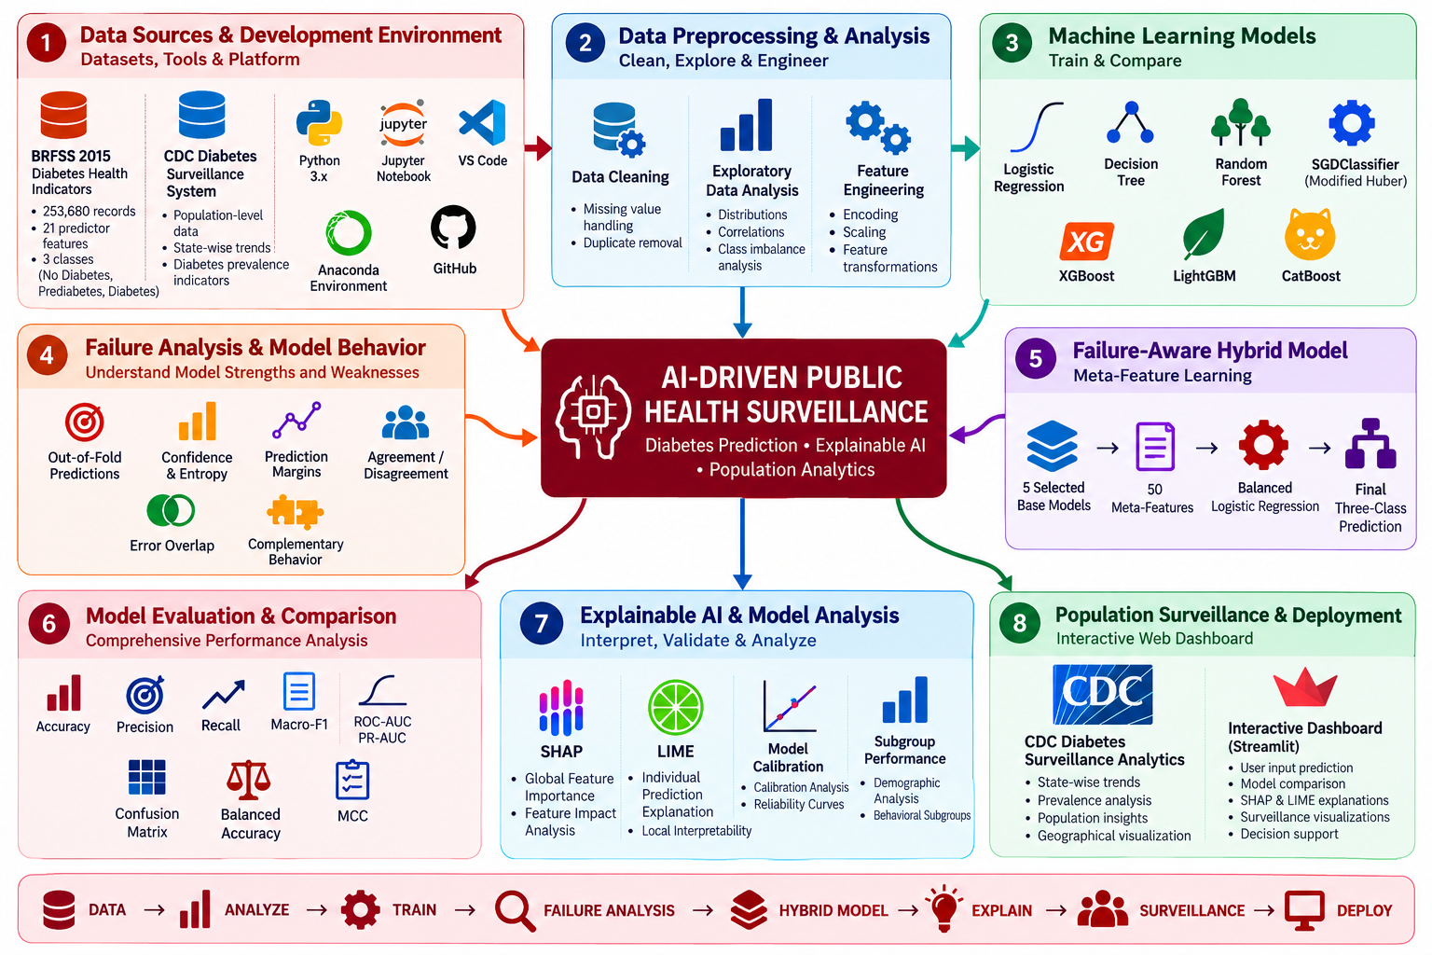
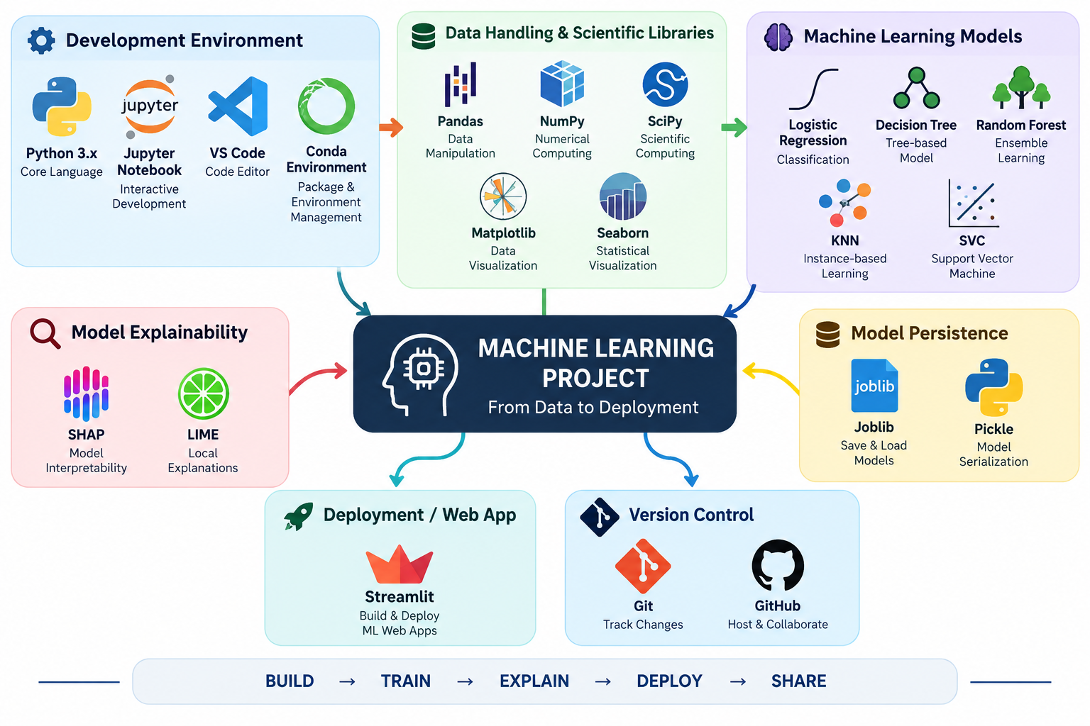

MODERN TOOLS & TECHNOLOGIES USED
TOOLS

Slide 6
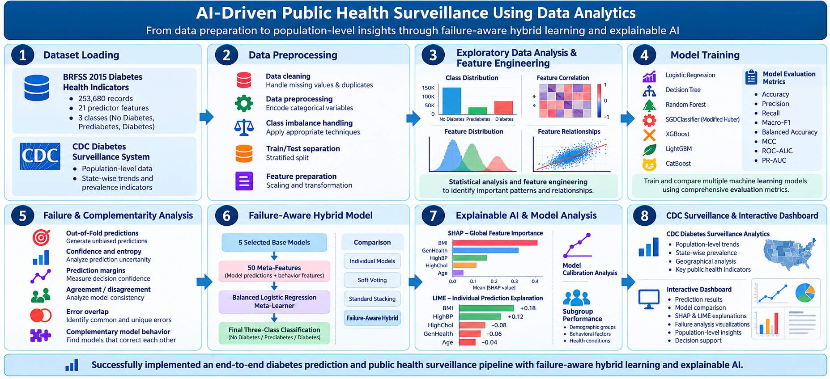
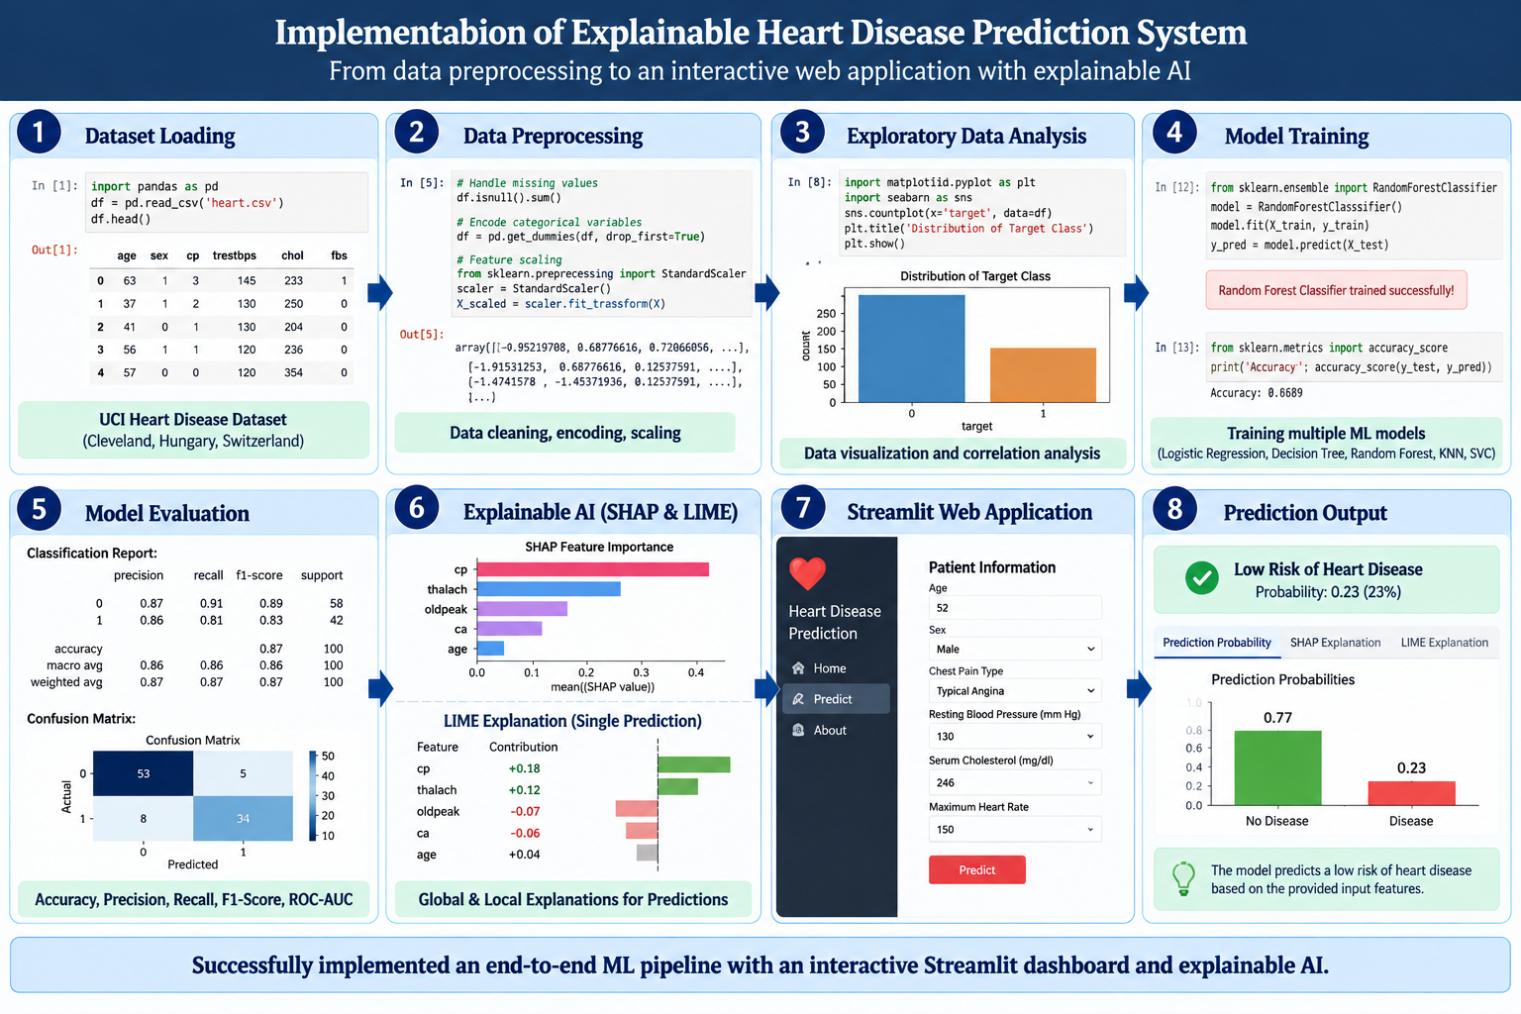
IMPLEMENTATION

Slide 7
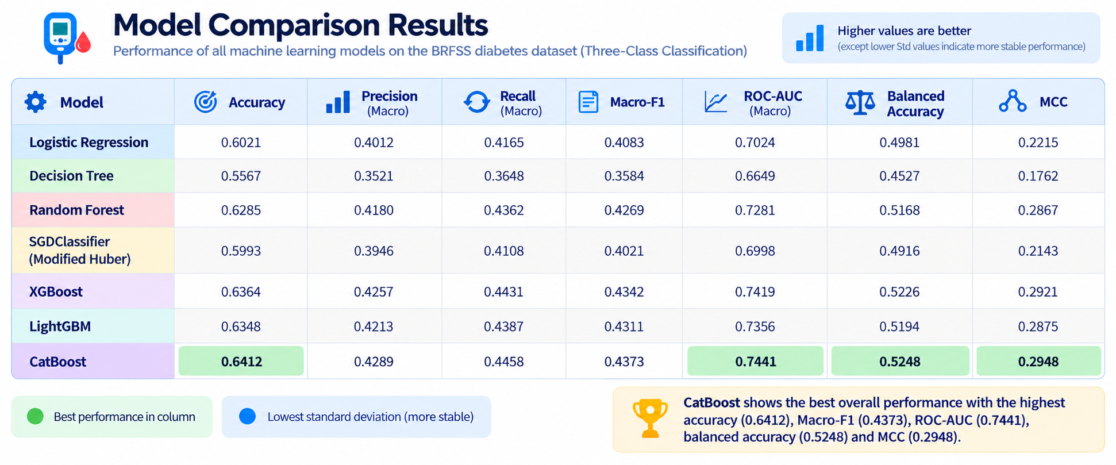
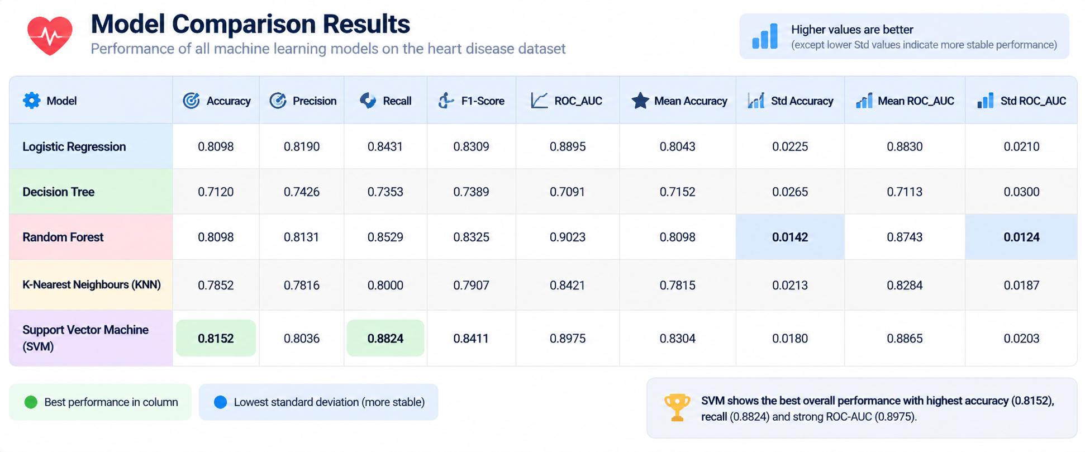
RESULTS

Slide 8
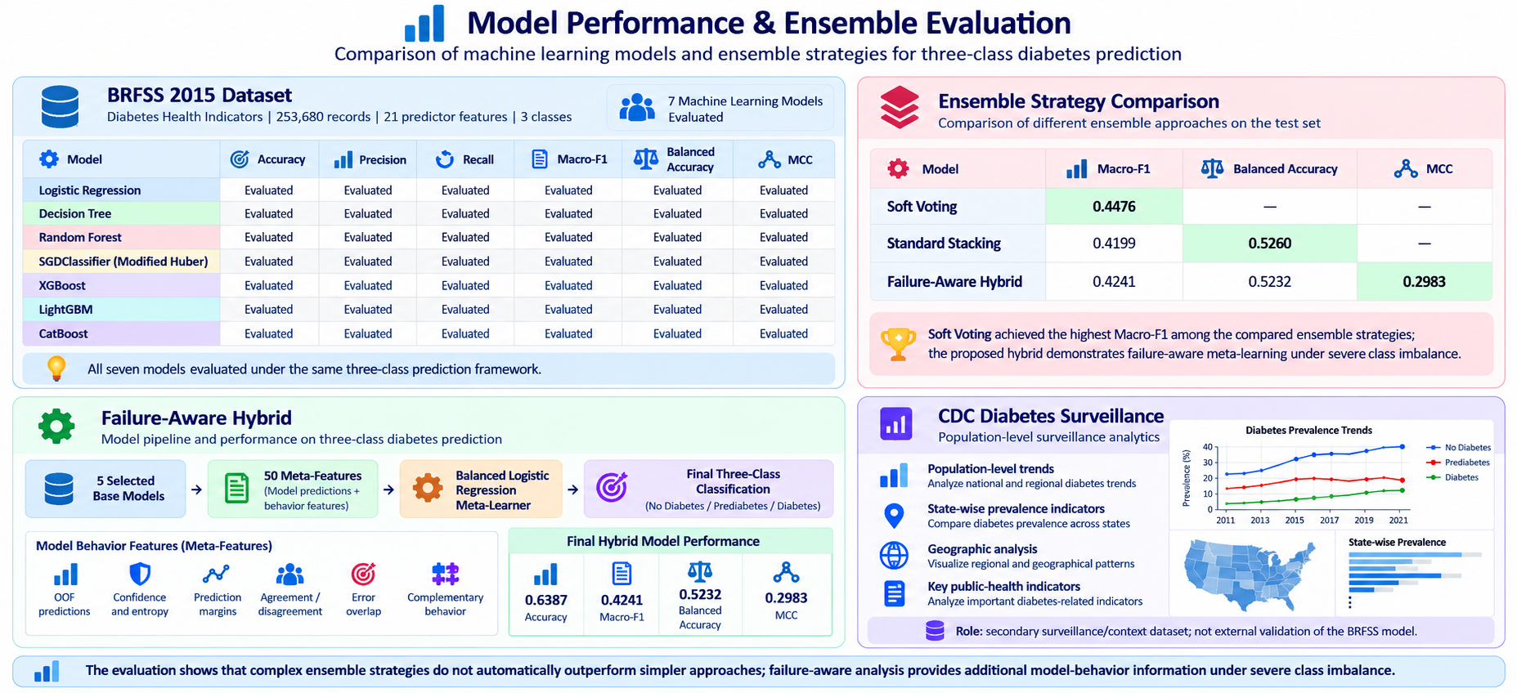
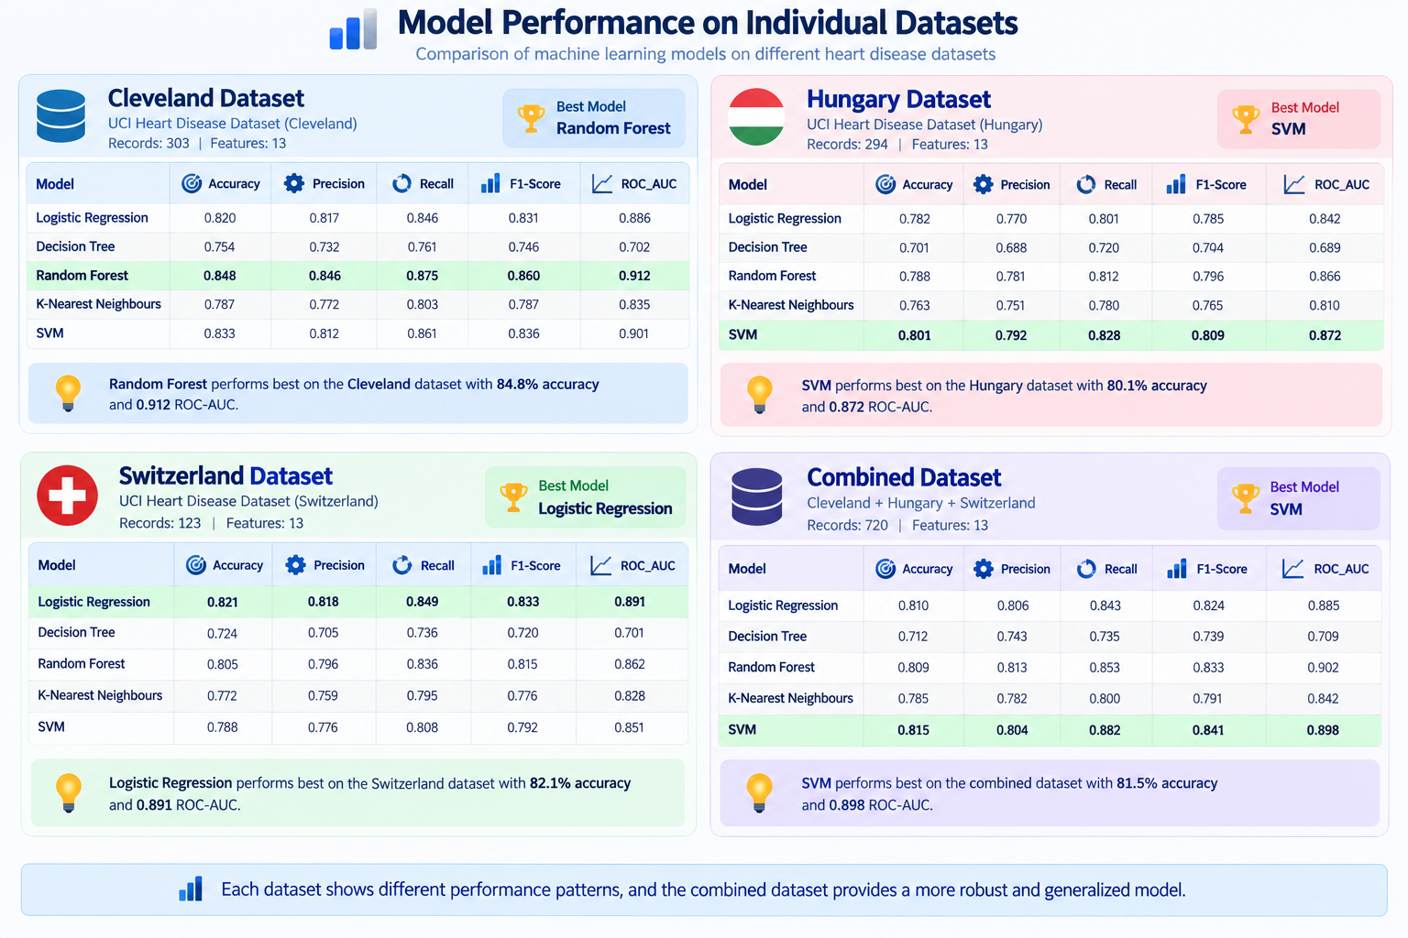
PERFORMANCE EVALUATION

Slide 9
THANK YOU

